Slide 1
The Nucleus’ Physical Role in Collective Cell Migration
Presented By: Brady Hine
Notes:
Hi, I’m Brady and the specific problem I’ll be trying to address this year in MECH 498 is how mechanical properties of the cell nucleus affect the process of collective cell migration.

Slide 2
Significance
Collective migration
Nucleus as a limiting factor
Cell repopulation
Wound healing
Developmental tissues
Cancer metastasis
Stiffness
Size
Mechanically active
Nuclear piston
Petrie, R. J., Koo, H., & Yamada, K. M. (2014). Generation of Compartmentalized Pressure by a Nuclear Piston Governs Cell Motility in 3D Matrix. Science (New York, N.Y.), 345(6200), 1062. https://doi.org/10.1126/SCIENCE.1256965
Notes:
So why is this important? Well, collective cell migration is a necessary function for many biological processes to work effectively. Whether that be repopulation of cells after tissue engineering, wound healing, formation of developmental tissues, or cancer metastasis in which it works too effectively. The nucleus’ importance in this process is that it serves as a limiting factor for migration. The nucleus tends to be much stiffer than the rest of the cell in a eukaryotic sense and it is the largest organelle. This causes the nucleus to limit movement whether it is carried along in a planar manner or forced to squeeze through tight pores or fibrous tissues. The nucleus is also mechanically active and can regulate its stiffness in response to external mechanical factors by up or downregulating lamin production in the nuclear envelope. Another neat role the nucleus can play is as a piston in 3D cell migration where the nucleus physically compartmentalizes the cytoplasm and builds a hydrostatic pressure between itself and the leading cell edge.

Slide 3
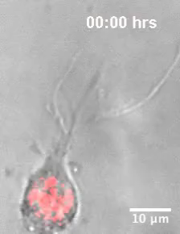
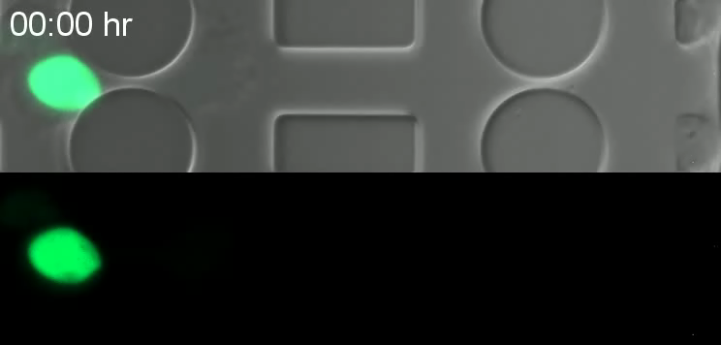
Visualization
Lee, H. P., Alisafaei, F., Adebawale, K., Chang, J., Shenoy, V. B., & Chaudhuri, O. (2021). The nuclear piston activates mechanosensitive ion channels to generate cell migration paths in confining microenvironments. Science Advances, 7(2). https://doi.org/10.1126/SCIADV.ABD4058
Denais, C. M., Gilbert, R. M., Isermann, P., McGregor, A. L., Te Lindert, M., Weigelin, B., Davidson, P. M., Friedl, P., Wolf, K., & Lammerding, J. (2016). Nuclear envelope rupture and repair during cancer cell migration. Science, 352(6283), 353–358. https://doi.org/10.1126/SCIENCE.AAD7297
Notes:
Now let’s take a quick look at some videos. On the left here a cell is migrating through a microfluidic channel with some very small constrictions with DNA-binding proteins highlighted in green. As the cell is moving through the channel it’s very clear how the nucleus can be a limiting factor for this process. What’s especially interesting here is that the cell ruptured the nucleus to fit through the space and was then able to reform the nuclear envelope, a process only seen in cancer cells like this one here (breast cancer). On the right side we can observe the process in which the nucleus, highlighted in red, works as a piston creating a pressure to expand cell protrusions and increase their volume.

Slide 4
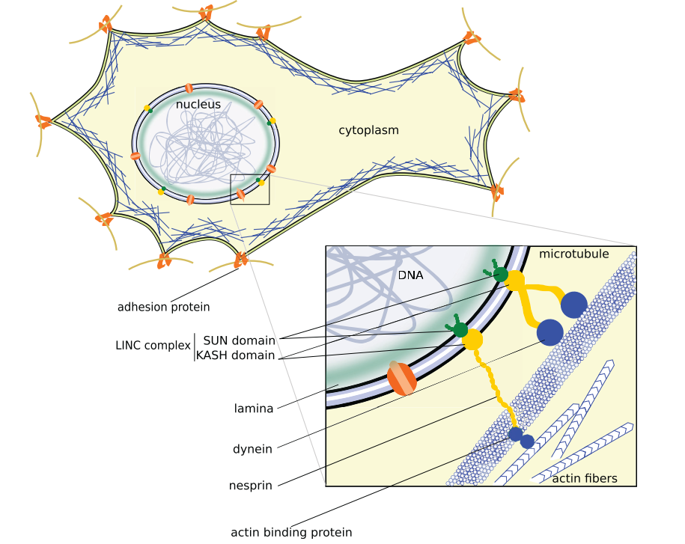
Background
Cell movement
Actin network
LINC complex
Migration
Single vs. collective
Cell-cell interactions
A. Fruleux and R. J. Hawkins, “Physical role for the nucleus in cell migration,” J. Phys. Condens. Matter, vol. 28, no. 36, p. 363002, Jul. 2016, doi: 10.1088/0953-8984/28/36/363002.
Notes:
Getting into some background information, the main way that cells move is by forces generated from the actin network and myosin motor proteins. This movement is generally in response to chemical or mechanical signals outside the cell detected by focal adhesions connected to the cytoskeleton. The cytoskeleton is also attached to the nucleus by the LINC complex shown here composed of transmembrane proteins connecting nuclear lamina to actin fibers and microtubules. The green lamina seen here is composed of intermediate filaments, known as lamin, and serve to give the nucleus its rigidity. Something also important to understand is that the process of migration is different between single cells and a group, sheet, or chain of cells moving together known as collective migration. This difference comes from additional forces experienced from cell-cell adhesions allowing for chemical and mechanical communication between the cells as they move together.

Slide 5
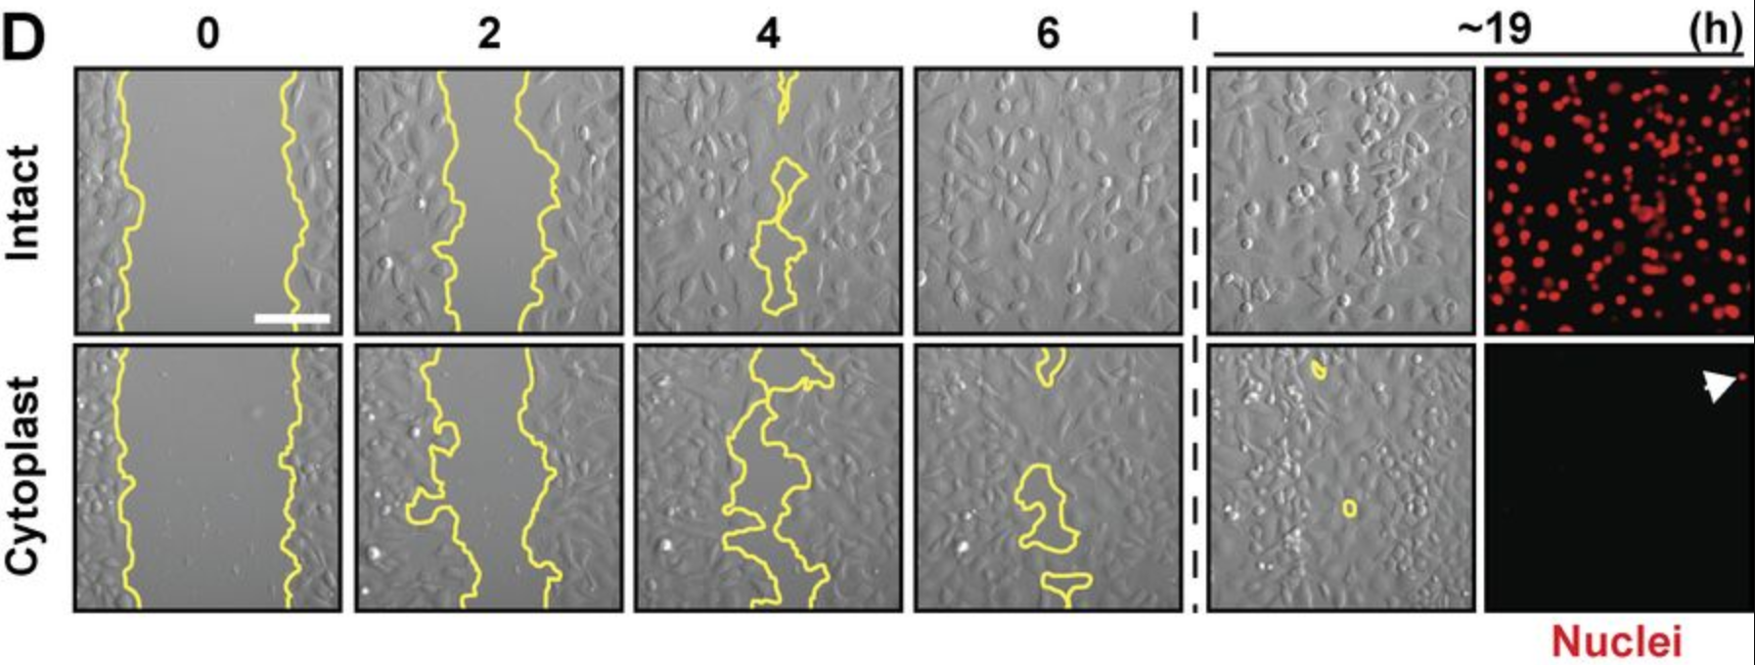
Previous Approaches
Enucleated mammal cells
Only planar migration
Decreased migration efficiency
D. M. Graham et al., “Enucleated cells reveal differential roles of the nucleus in cell migration, polarity, and mechanotransduction,” J. Cell Biol., vol. 217, no. 3, pp. 895–914, Mar. 2018, doi: 10.1083/JCB.201706097.
Notes:
Previous work that has looked into the nucleus’ physical role in collective cell migration started by using enucleated mammal cells or cytoplasts and compared their migratory abilities to those of intact cells. It was found that the cytoplasts were only able to migrate in a planar manner and no longer in a 3D space. The planar migration had also decreased in efficiency for the cytoplasts as seen by results from a scratch wound assay here with intact cells closing the wound fully at 6 hours and the cytoplasts still not fully closing the wound after 19 hours. These results showed that the nucleus is critical for proper cell mechanical response.

Slide 6
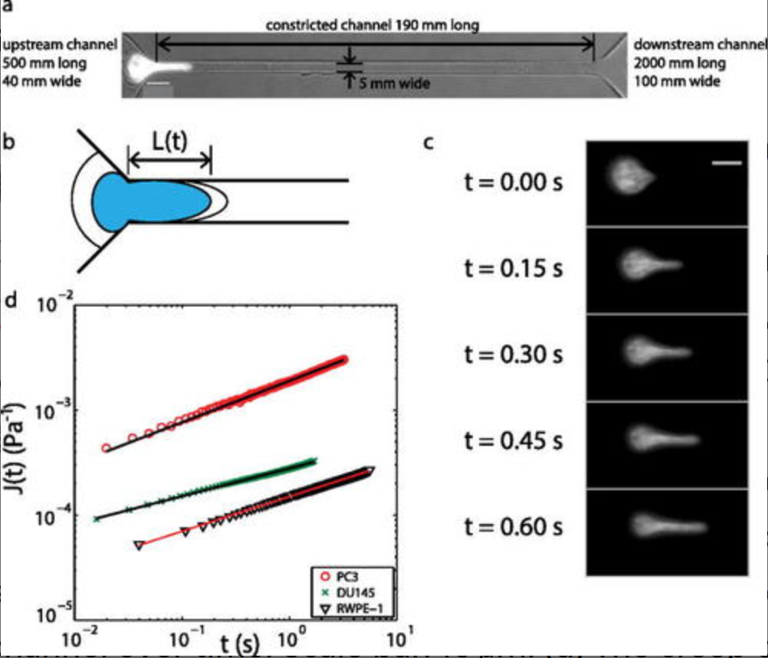
Previous Approaches
Metastatic prostate cancer
Cancer vs. normal cell nucleus
Varied aggressiveness
Z. S. Khan, J. M. Santos, and F. Hussain, “Aggressive prostate cancer cell nuclei have reduced stiffness,” Biomicrofluidics, vol. 12, no. 1, p. 014102, Jan. 2018, doi: 10.1063/1.5019728.
Notes:
Another approach involved investigating nuclear differences in varying levels of metastatic prostate cancer. The team conducted a nuclear creep experiment using a microfluidic channel with a narrow constriction and observed the time required for these different cells to enter the constricted channel. Their results showed that more highly metastatic cancer cells were able to travel faster through confined environments than those less metastatic. The imaging from these tests then allowed the researchers to measure the nuclear stiffnesses of the cells and found a trend that the more aggressive the cancer cell was, the softer the nucleus was.

Slide 7
Roadmap
Establish a cell migration assay
Technique validation
Modify mechanical properties
Cytoskeletal and nuclear strain mapping
Notes:
And that leads me to my plan for this academic year which involves observing the impacts that changing nuclear mechanical properties has on the process of collective cell migration. I’m currently working to establish a cell migration assay which will soon be followed by technique validation using actin or myosin blockers. From here, drugs will be used to modify nuclear mechanical properties by and observe changes from the control group. The final step planned for this academic year involves using high resolution imaging of the nucleus and cytoskeleton to develop strain maps of the cell monolayers to see treatment effects as they pertain to the whole monolayer. Initial experimentation will be done using NIH-3T3 cells and, if time allows, the experiments will be repeated using mesenchymal stem cells.

